Slide 1


Slide 2
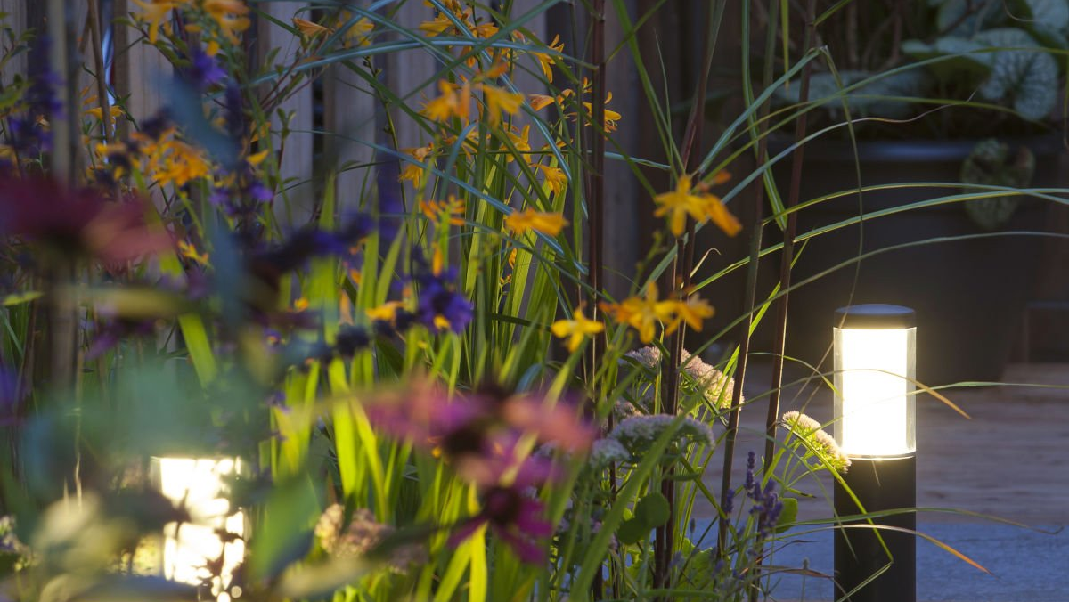
Table of Content
1
5
Introduction
Findings
2
6
Team Presentation
Customer insights
3
7
Partner Presentation
Recommendations
4
8
Data Gathering and Analysis
Conclusion
Notes:
Drag & drop to add a picture in the placeholder

Slide 3
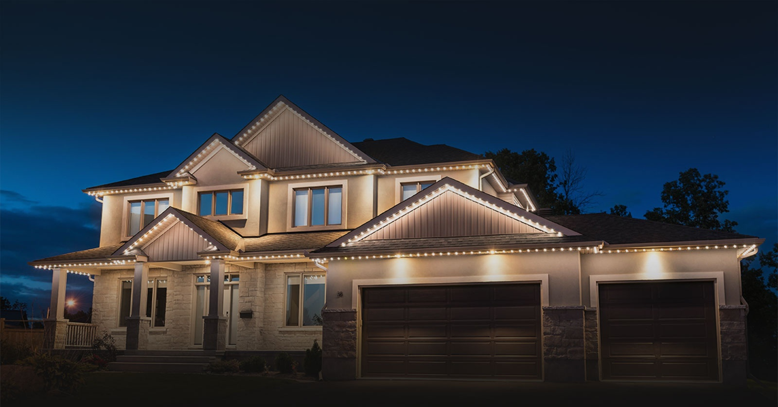
01
Introduction
The project transposes into a refining of BrightKnight’s marketing strategy using the latest Business analysis methods.
Notes:
Drag & Drop to add a picture in the back placeholder

Slide 4
Team members
Saad JLIL
Rami Al-Alami
Abhay Kalia
Valeriia Kostiuchenko
Catherine Acosta

Slide 5
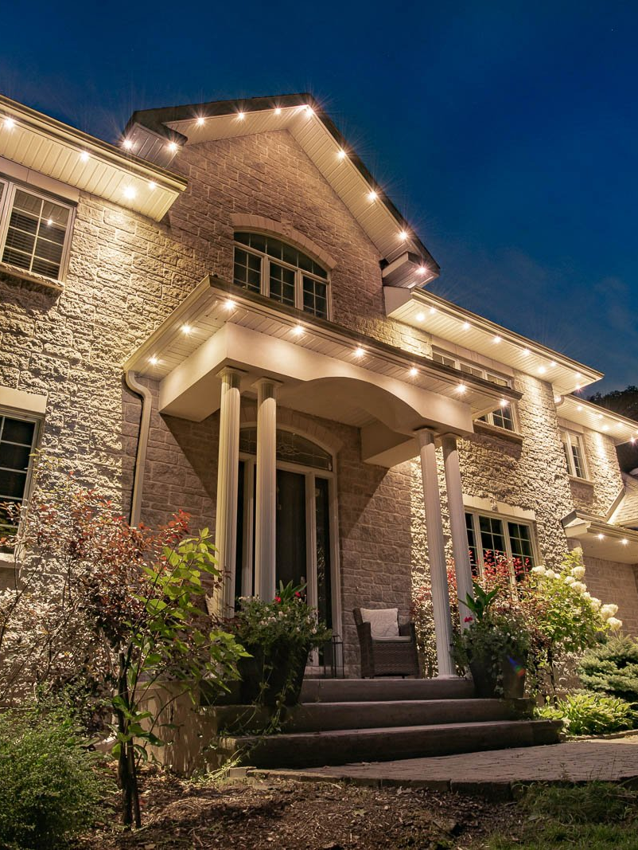
Partner presentation
Bright Knights, an outdoor lighting installation startup.
Renowned for transforming outdoor spaces, they collaborate with us to enhance beauty and allure.
Our collaboration aims to further their success in elevating outdoor spaces to new heights of allure and beauty.
https://www.thebrightknights.com/
Notes:
Drag & Drop to add a picture in the placeholder

Slide 6
Data gathering and analysis

Slide 7
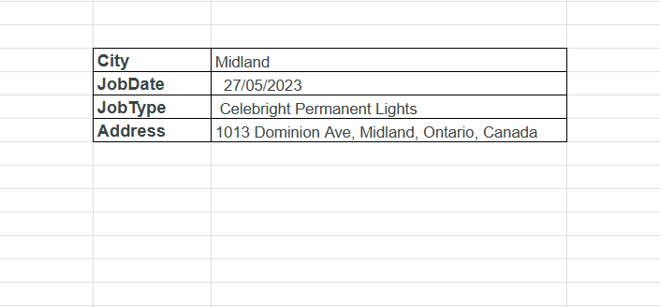
Data Gathering
Customer data:
The following are the composites of our customer data:
City
Order Date
Type of product/service purchased
The customer address
Notes:
Drag & drop to add a picture in the placeholder

Slide 8
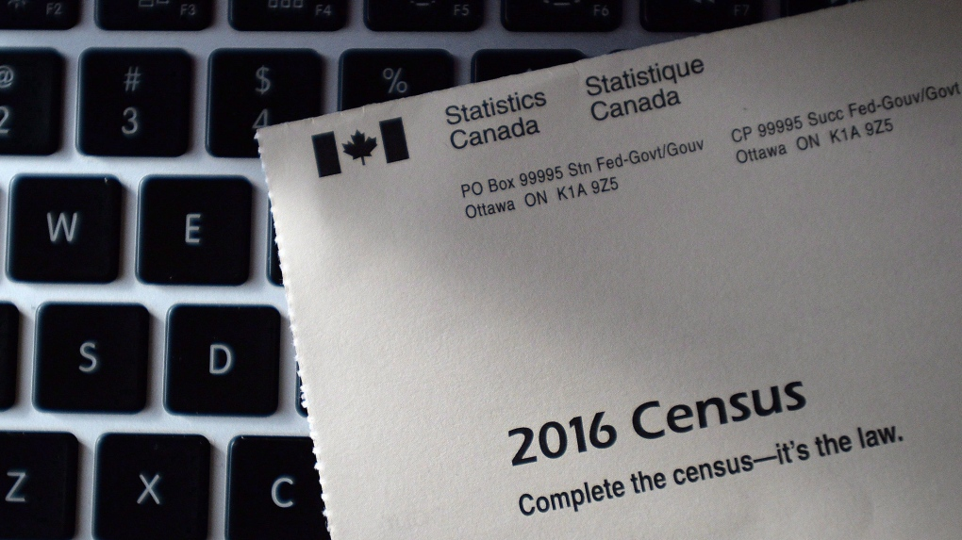
Data Gathering
Canadian census data
Using different automation methods, we were able to:
Gather all customer census data (71 customers with 122 census data points)
Gather all regional census data (600+ non-customers with 122 census data points)
Census Data contains: Average household income, average number of rooms in the household etc…
Notes:
Drag & drop to add a picture in the placeholder

Slide 9
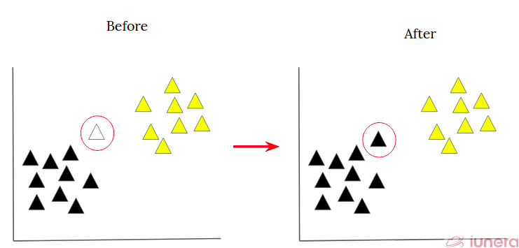
Data analysis
Employed K-means and KNN models
Visualized the analytical method to illustrate how streets relate to the customer population data, facilitating understanding of potential client hubs.
Generated a table of 600+ Barrie addresses with distance scores, indicating streets with shorter distances as potential hubs for potential clients.
Notes:
Drag & drop to add a picture in the placeholder

Slide 10
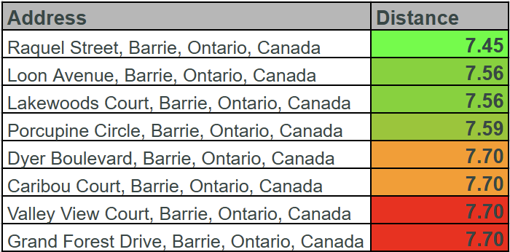
Data analysis
The distance represents the similarity with our customer dataset’s census data.
The smaller the distance the higher the probability that the address contains potential and targetable customers
Notes:
Drag & drop to add a picture in the placeholder

Slide 11
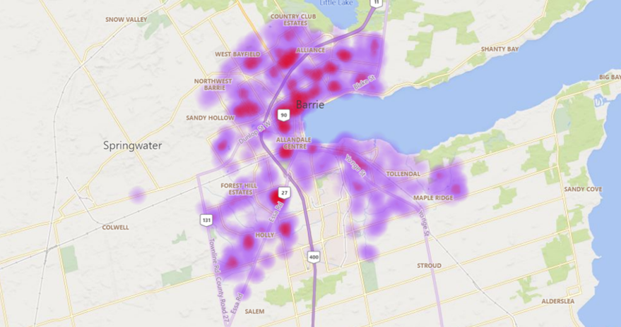
Regional analysis
Data transposition: Regional heatmap
We have transposed the distance
Notes:
Drag & drop to add a picture in the placeholder

Slide 12
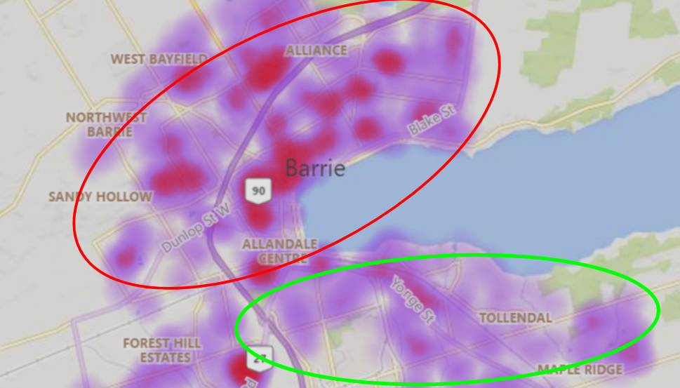
Regional analysis
Region Summary
A closer examination of the map reveals a prevalence of purple shading in the southern regions, reaffirming that the south (southeast to be more precise) represents the most conducive territory for sales. Conversely, the northern areas predominantly shaded in red signify a lower likelihood of favorable sales opportunities, emphasizing the less favorable market prospects in that direction.
Notes:
Drag & drop to add a picture in the placeholder

Slide 13

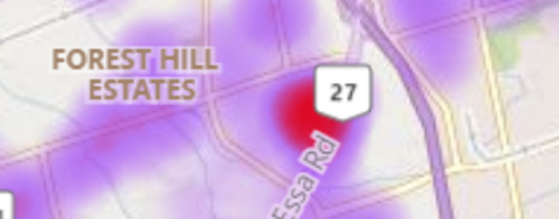
Here, we've identified the areas least conducive to potential sales (red). We can see a clear trend where purple consistently surrounds these red zones. From this, we can infer that it's highly probable that prospective clients (purple) are situated around those locations (red) where there's potentially the least client presence.

Slide 14

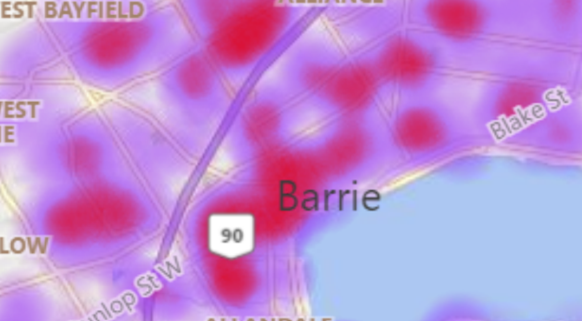
Urban vs. Suburban Areas
Downtown areas, shaded in red, suggest lower sales prospects due to prevalent apartment living, reducing the demand for outdoor lighting installations.
Outlying areas highlighted in purple indicate higher potential for outdoor lighting orders attributed to prevalent private homeownership, aligning with residents dwelling in private residences.
Analysis of the depicted image illustrates contrasting sales prospects between downtown (apartment living) and outlying areas (private homeownership) regarding outdoor lighting installations.
Notes:
Drag & Drop to add a picture in the placeholder

Slide 15
Clients insights

Slide 16
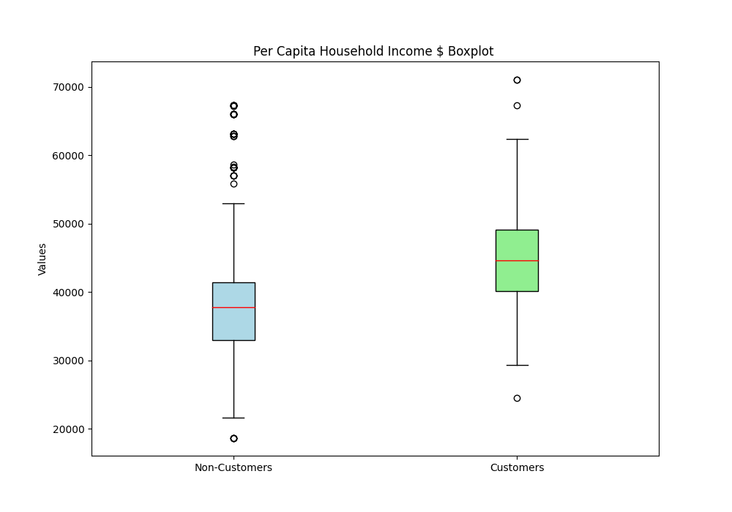
Customer household income

Slide 17
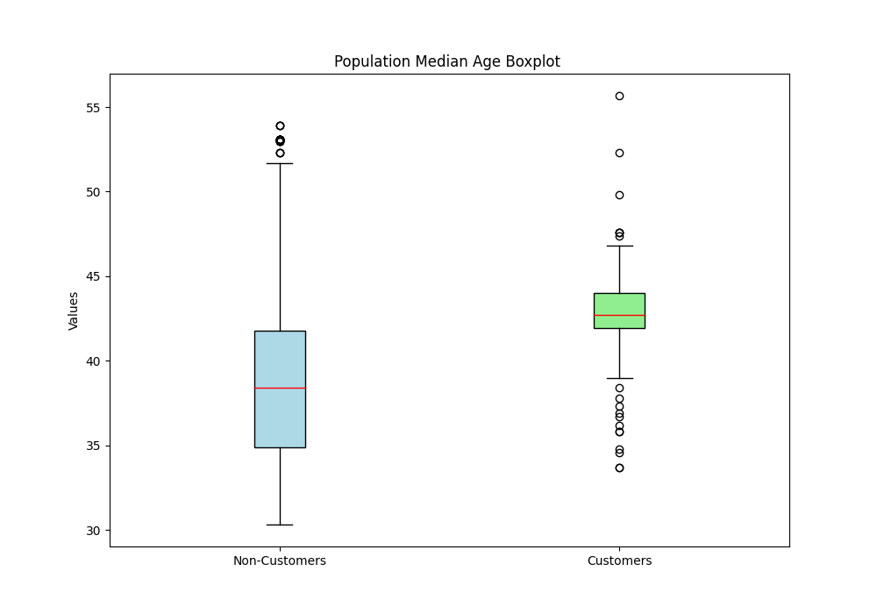
Customer average age range

Slide 18
Insight summary
Post highschool education is one factor in which our clientele exceeds.
Our customers tend to have higher rates of marriages compared to the general population in the region
Post High School education
Marriage 1
On average, our customer population is older than the rest of the region
Age
Our customers are relatively more family-oriented.
Family
Household income
Higher household incomes seem to follow the trend
Ownership
The clientele tends to live in areas with higher rates of residential home ownership.

Slide 19
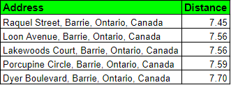
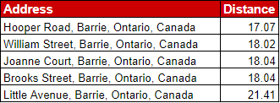
most favorite areas
Area Analysis:
Analyzing areas suggested by our predictive model, we use tools like Google Maps and Canadian Census data to understand client patterns and assess prediction accuracy. Our focus lies on visually exploring neighborhoods with the highest linear distance, revealing insights into common traits of these least favorable parts, enhancing our understanding of their ranking factors.
least favorite areas

Slide 20
Least favorite areas

Slide 21
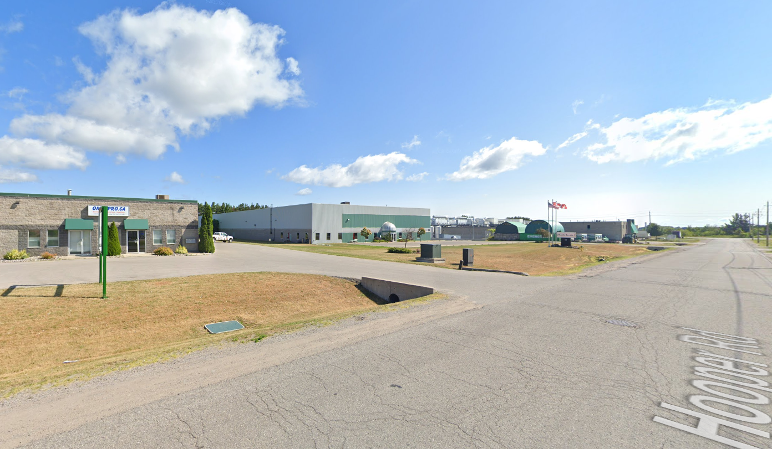
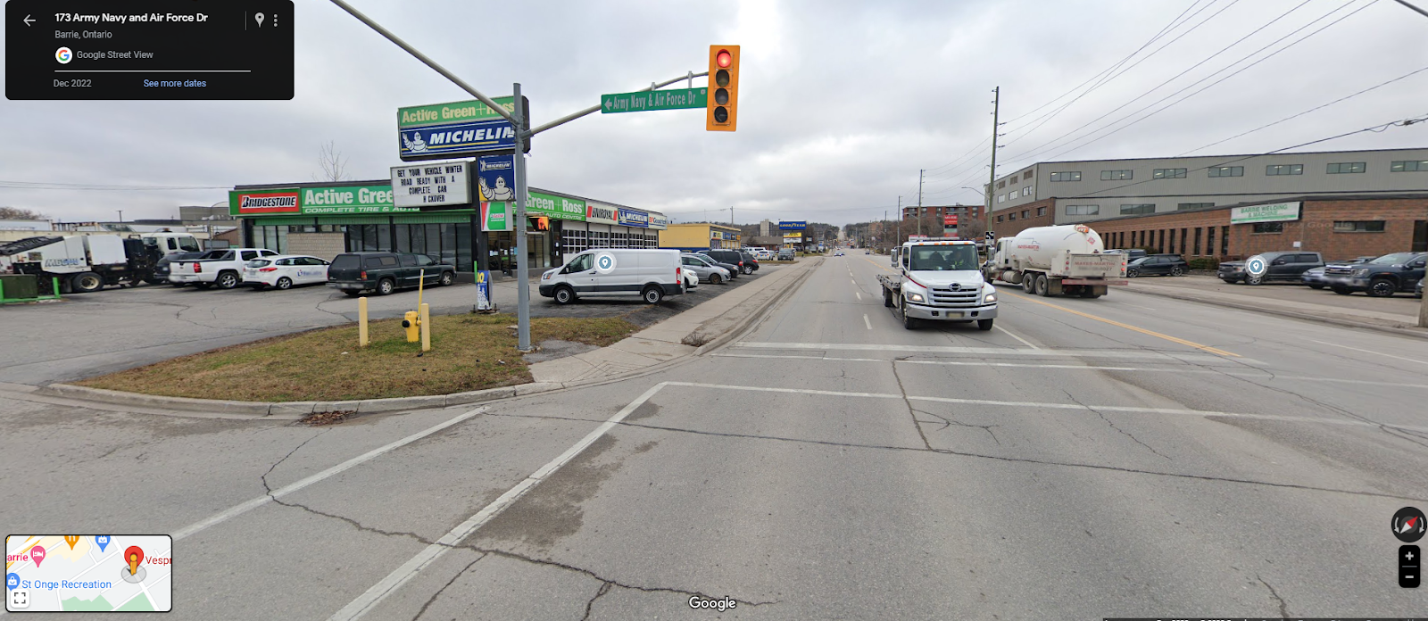
Industrial Areas
Industrial areas show little appeal for installing lights, making it a less favored option due to multiple factors like cost considerations and operational priorities.
The disinterest in lighting installations may stem from perceptions that adequate lighting might not significantly impact industrial processes.
Understanding and addressing underlying reasons behind this lack of interest is crucial for promoting the adoption of lighting solutions within industrial settings.

Slide 22
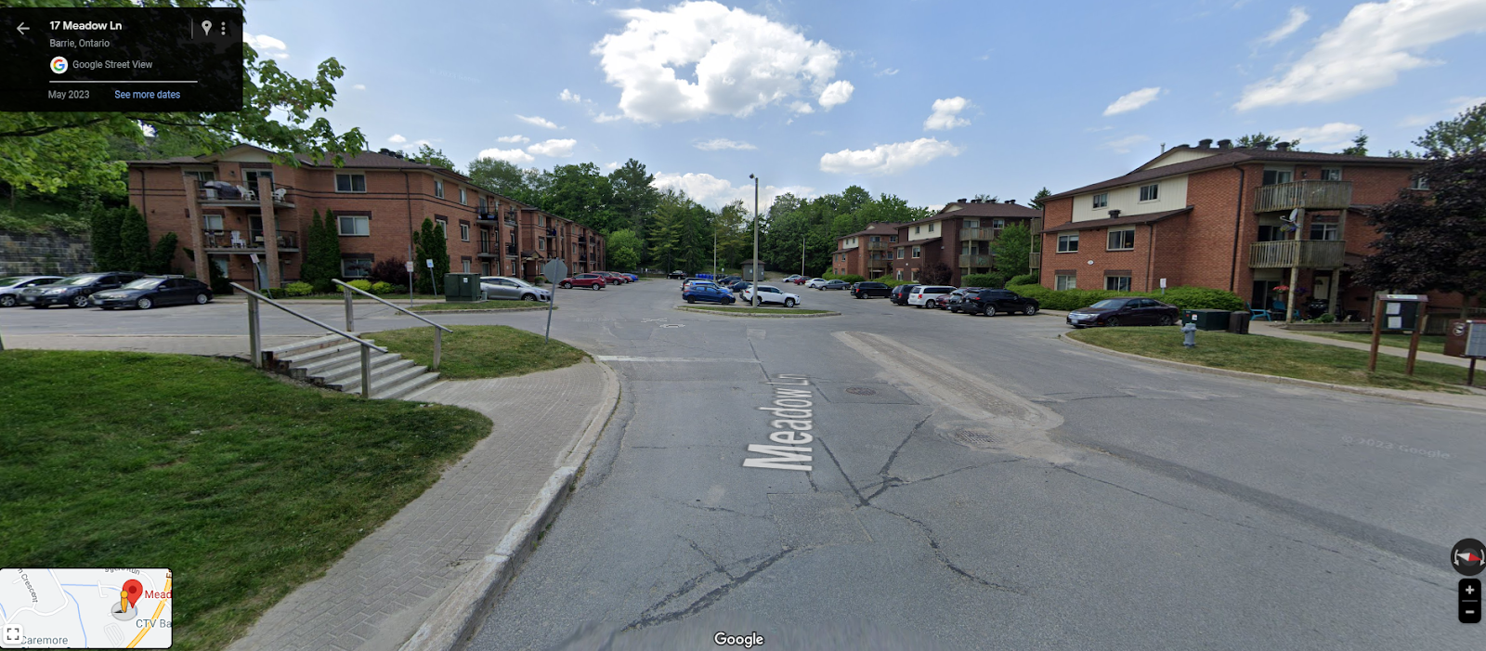
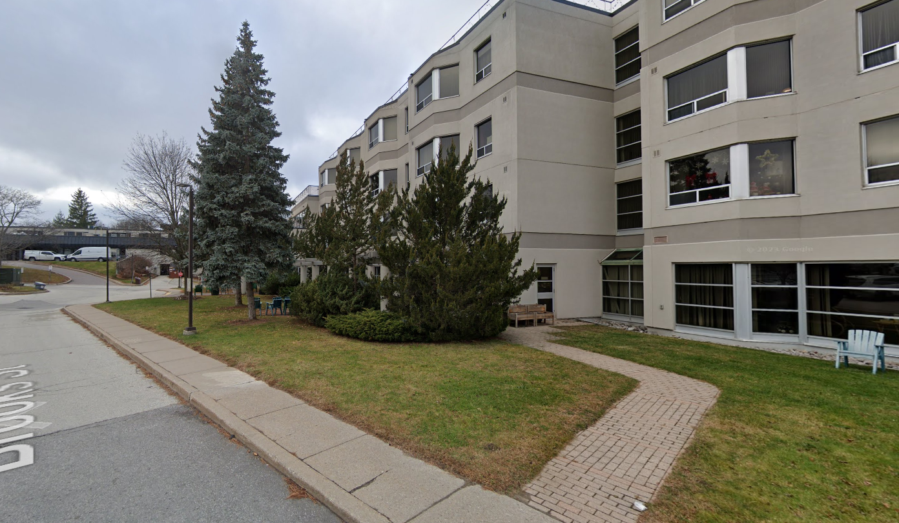
Townhouses and Apartment Buildings:
Townhouses and apartment buildings exhibit limited enthusiasm for installing lights, marking it as a less preferred option.
Property owners in these settings might prioritize other maintenance or improvement aspects over outdoor lighting installations.
Contracting with a small company could be less appealing for apartment complexes seeking lighting solutions.

Slide 23
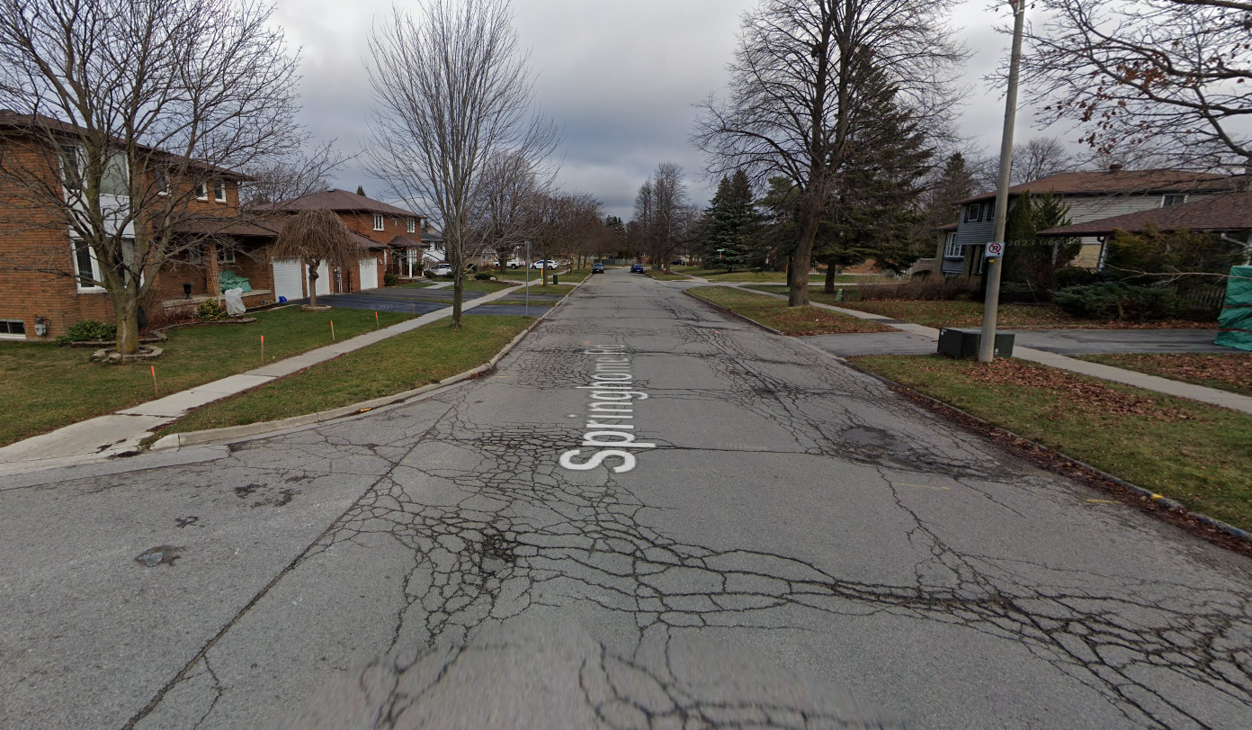
Low maintenance:
Our algorithm identifies factors like neighborhood maintenance budgets, impacting street rankings.
The image of one of the lowest-ranked streets exemplifies the impact of a low maintenance budget on a neighborhood.
These areas typically consist of non-targetable profiles, highlighting the influence of budget constraints on neighborhood characteristics.

Slide 24
most favorite areas

Slide 25
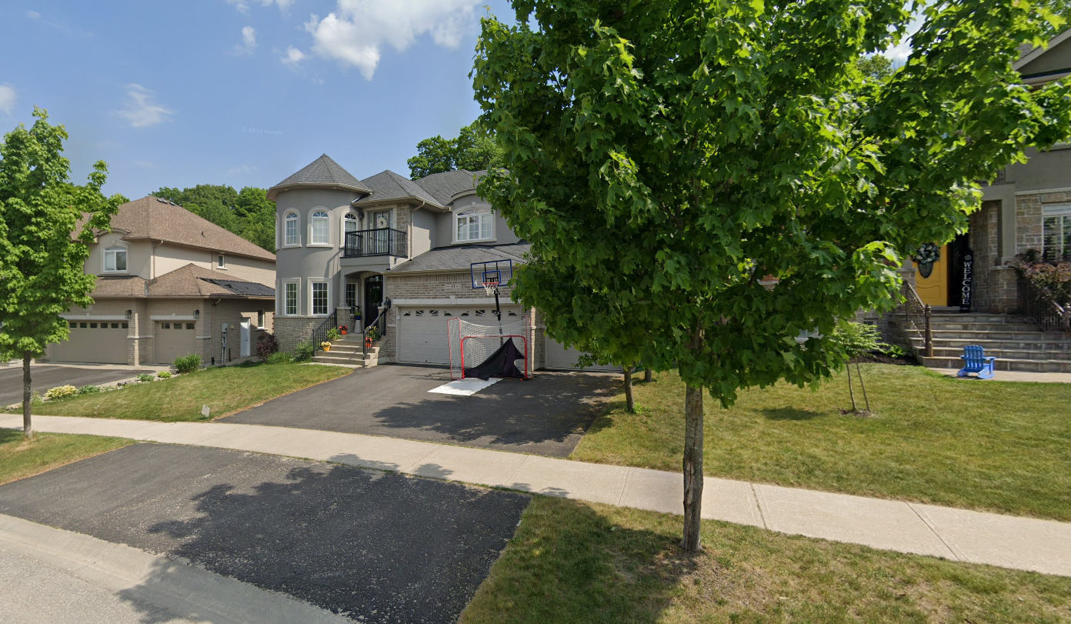
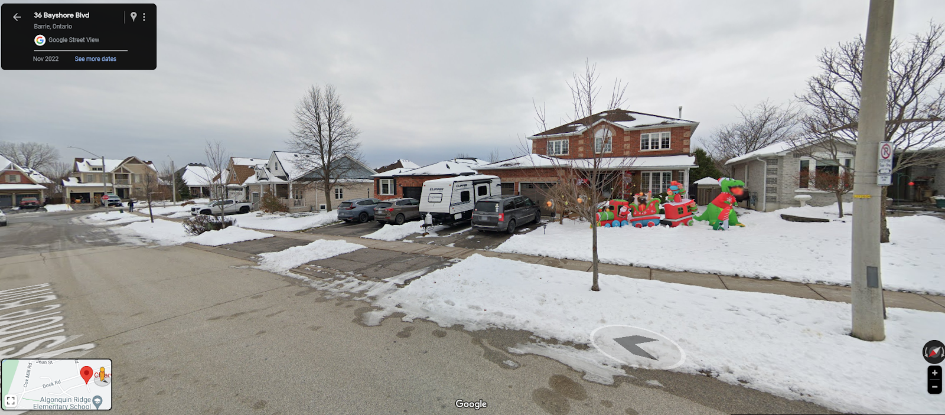
Family Friendly:
Our clientele exhibits a strong inclination towards family orientation, reflected in our model's identification of areas with high census family rates.
The visual representation showcases evident signs such as increased presence of playgrounds and family-oriented decorations in these areas.
The model's observation of high family rates aligns with the visual presence of family-centric amenities, indicating areas appealing to our clientele.

Slide 26
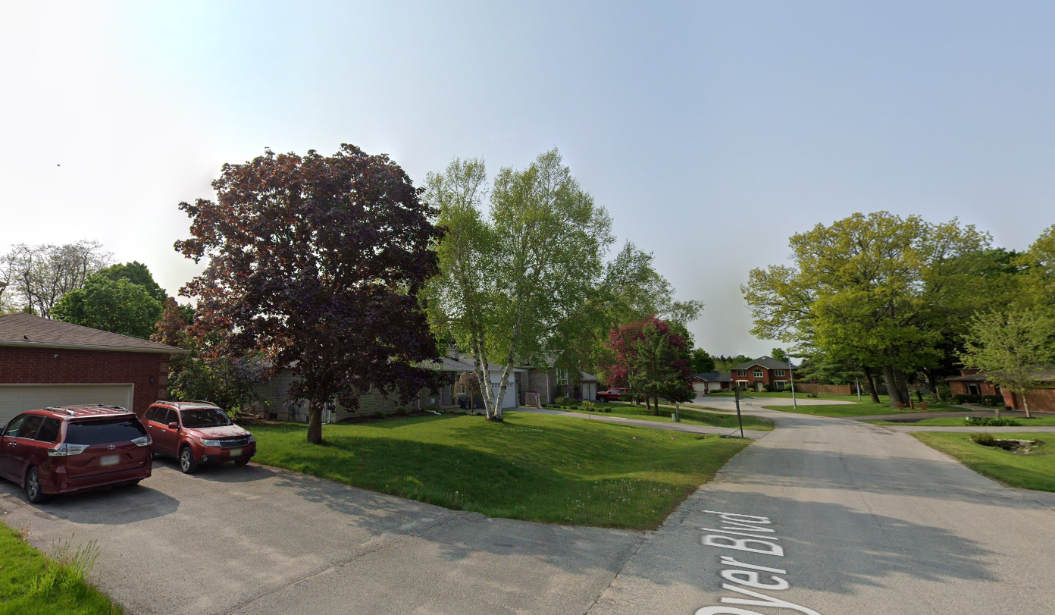
Larger property surface areas:
Larger backyards correlate with a higher demand for outdoor light installations, noted as a trend by our model.
The model specifically selects residential areas with extensive backyards due to the increased need for outdoor lighting in these locations.
The model's selection of areas with larger backyards highlights the relevance of yard size in determining the necessity for outside light installations in residential spaces.

Slide 27

Recommendations and Conclusion:
Customer Targeting Strategy: Discuss the comprehensive analysis and actionable insights for Bright Knights, recommending targeted marketing aligned with customer profiles and geographic preferences to maximize outreach.
Customer Segmentation's Impact: Emphasize the importance of segmenting customers based on behaviors and preferences for tailored marketing approaches, stressing continuous data gathering for sustained relevance.
Technology Integration for Efficiency: Propose integrating CRM systems or data analytics tools for improved insights, streamlined operations, and a systematic approach to customer targeting.
Financial Implications: Include estimated ROI projections or cost-benefit analysis to showcase the potential returns of implementing recommended strategies, aiding decision-making processes.

